Slide 1

Advanced Analysis of Algorithms
Instructor: Dr. Muhammad Afzal
Ayesha Atif 2020MSCS578
Hamza Farooq 2020MSCS513
Komal Shehzadi 2020MSCS590

Slide 2
Assignment # 1
There are 40320 possible sequences an 8 digit array e.g., [1, 2, 3, 4, 5, 6, 7, 8] which is 8!.
Separate ADD4, CMP8, CMP4, MMV8, MMV4 and overall cost is calculated and stored as three different files.
The results in three files are named as All, Distinct and tabular.

Slide 3
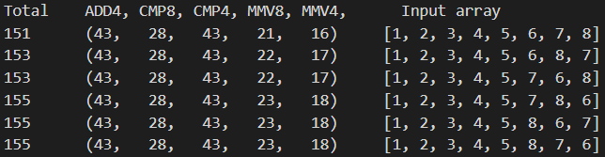
ALL.txt
In this file, each possible sequence is written with corresponding cost of individual operation and sum of the operations.

Slide 4
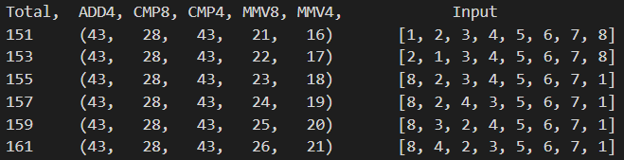
Distinct.txt
In this file, each sequence with different total cost is written with corresponding cost of individual operation and sum of the operations.

Slide 5
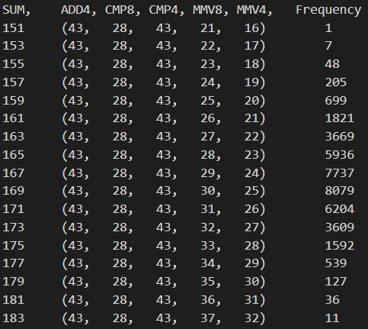
Frequency Table.txt
In this file, the corresponding number of sequences that have same total cost is written.

Slide 6
Assignment # 2
The inner while loop cannot be literally replaced with binary search because
It is not just returning the index of the element to be replaced but also it is moving the elements rightwards with each iteration. In other words, it is do performing an operation with each iteration.
Binary search can be included to get the index of element to be placed.

Slide 7
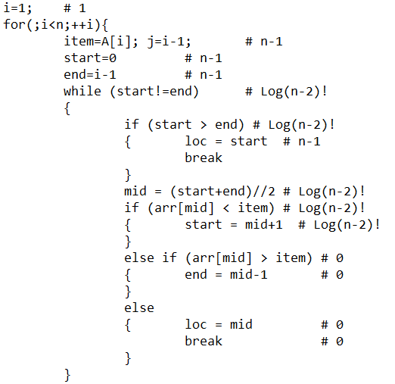
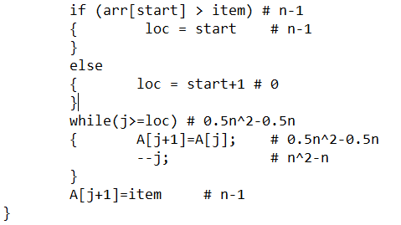
Algorithm

Slide 8
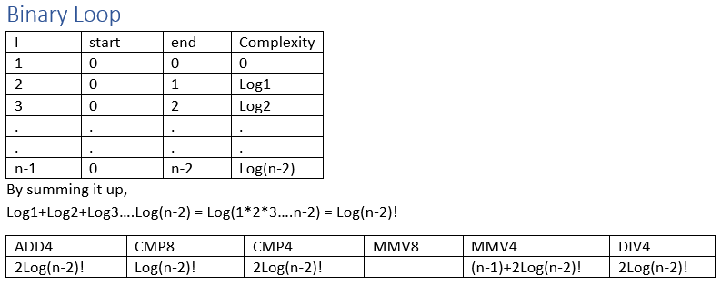
Calculations

Slide 9
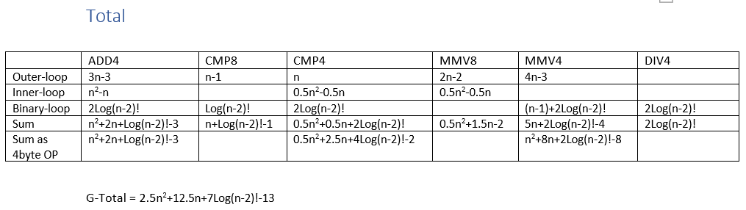
Calculations

Slide 10
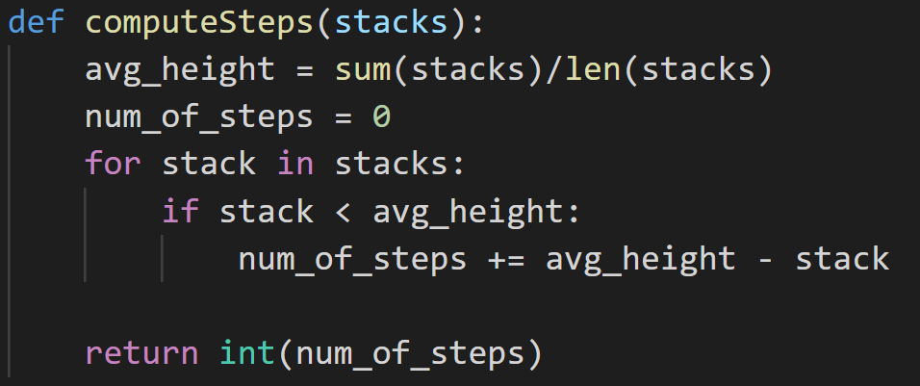
Assignment # 3

Slide 11
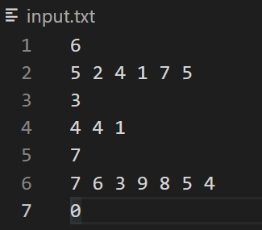
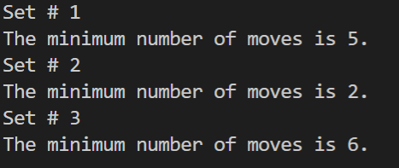
Sample Input Sample Output

Slide 12
Assignment # 4
Input Constraints to algorithm
Minimum coins = 3
Maximum fake coins = 1
Output:
Representation of each of comparison
Index of fake coin if exists and -1 otherwise

Slide 13
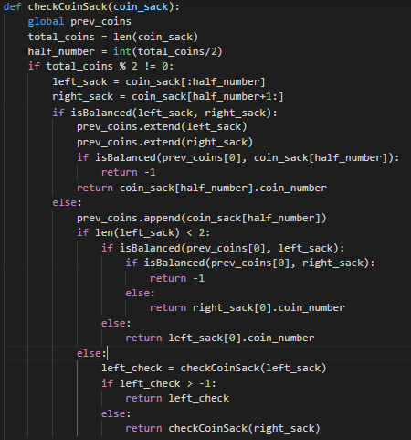
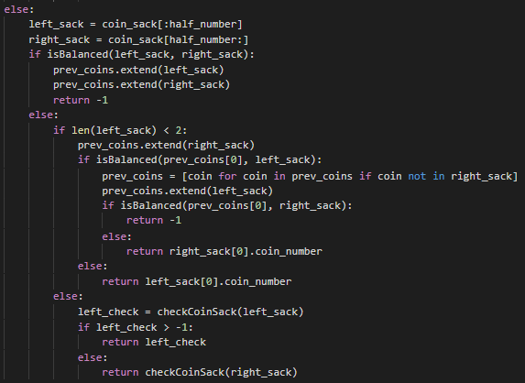
Algorithm

Slide 14
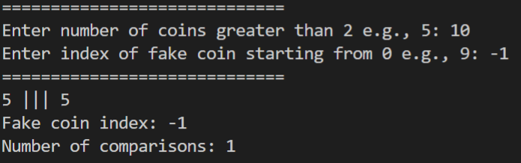
Best Case (n = 10 coins)

Slide 15
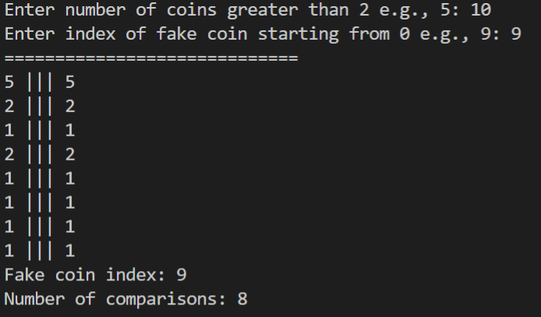
Worst Case (n = 10 coins)

